Slide 1
Foundations of Machine Learning
Module 3: Instance Based Learning and Feature Reduction
Part C: Feature Extraction
Sudeshna Sarkar
IIT Kharagpur

Slide 2
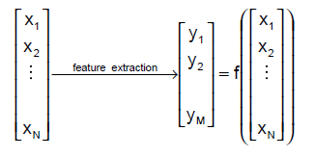

Feature extraction - definition
Given a set of features $F=\{x_{1}, …,x_{N}\}$
the Feature Extraction(“Construction”) problem is
is to map $F$ to some feature set $F′′$ that maximizes the learner’s ability to classify patterns

Slide 3
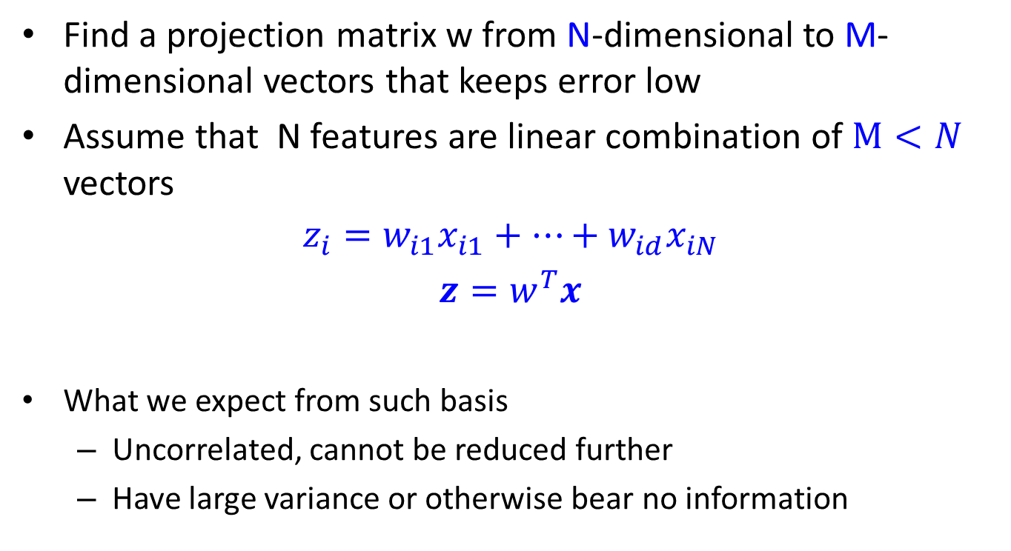
Feature Extraction
Find a projection matrix w from N-dimensional to M-dimensional vectors that keeps error low
Assume that N features are linear combination of $M<N$ vectors
$$z_{i}=w_{i1}x_{i1}+…+w_{id}x_{iN}$$
$$z=w^{T}x$$
What we expect from such basis
Uncorrelated, cannot be reduced further
Have large variance or otherwise bear no information

Slide 4
Geometric picture of principal components (PCs)

Slide 5
Geometric picture of principal components (PCs)

Slide 6
Geometric picture of principal components (PCs)

Slide 7
Algebraic definition of PCs
Given a sample of p observations on a vector of N variables
define the first principal component of the sample
by the linear transformation
where the vector
is chosen such that
is maximum.

Slide 8
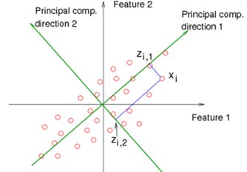
PCA

Slide 9
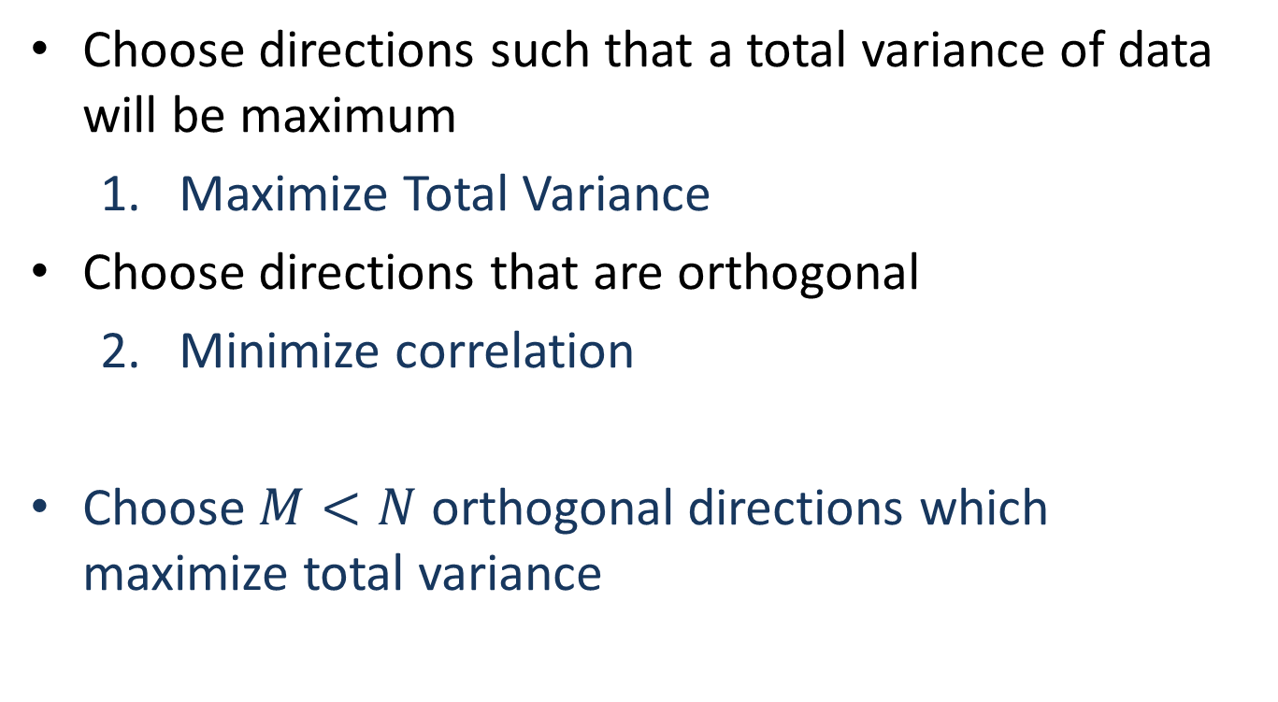
PCA
Choose directions such that a total variance of data will be maximum
Maximize Total Variance
Choose directions that are orthogonal
Minimize correlation
Choose $M<N$ orthogonal directions which maximize total variance

Slide 10
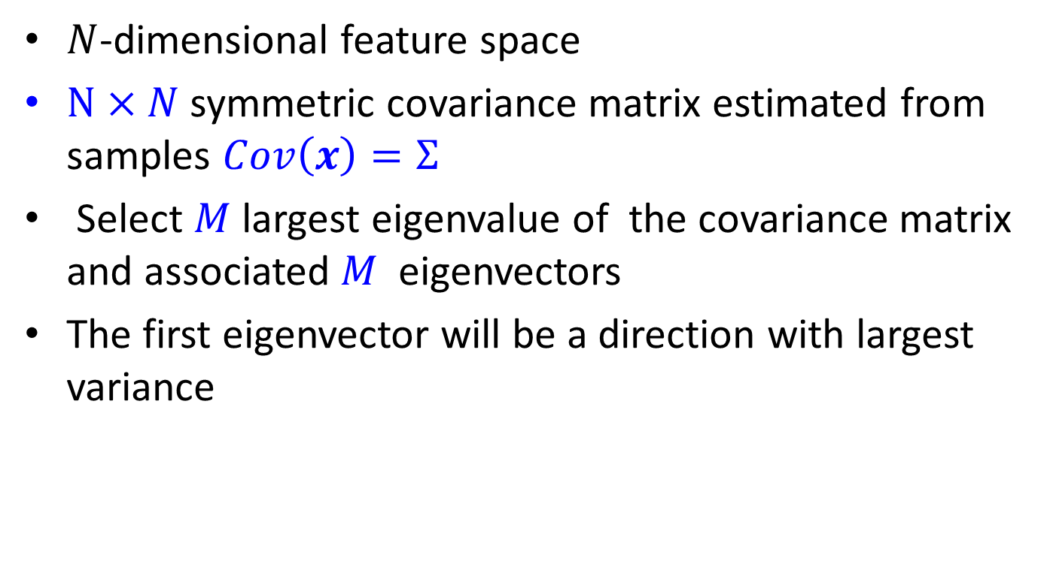
PCA
$N$-dimensional feature space
$N×N$ symmetric covariance matrix estimated from samples $Cov\left(x\right)=Σ$
Select $M$ largest eigenvalue of the covariance matrix and associated $M$ eigenvectors
The first eigenvector will be a direction with largest variance

Slide 11
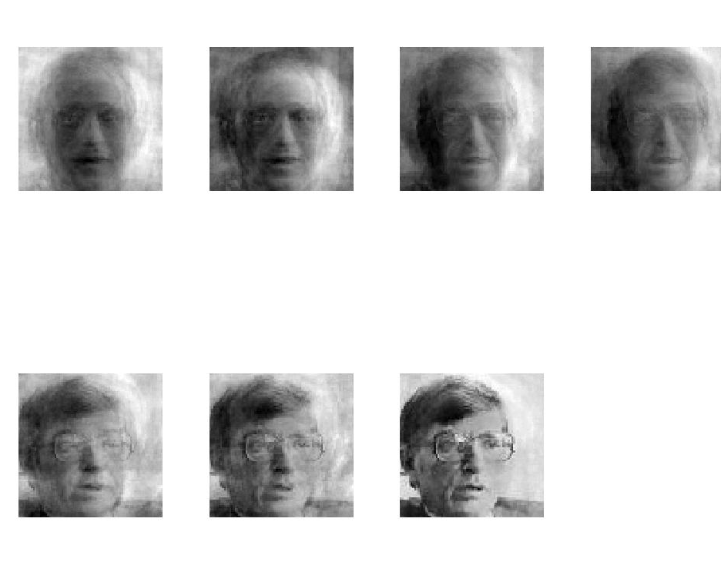
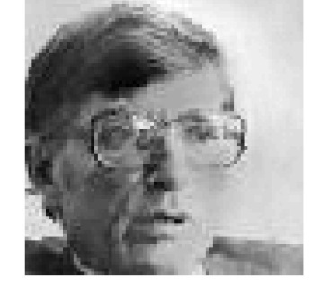
PCA for image compression
p=1
p=2
p=4
p=8
Original Image
p=16
p=32
p=64
p=100

Slide 12
Is PCA a good criterion for classification?
Data variation determines the projection direction
What’s missing?
Class information

Slide 13
What is a good projection?
Similarly, what is a good criterion?
Separating different classes
Two classes overlap
Two classes are separated

Slide 14
What class information may be useful?
Between-class distance
Distance between the centroids of different classes
Between-class distance

Slide 15
What class information may be useful?
Between-class distance
Distance between the centroids of different classes
Within-class distance
Accumulated distance of an instance to the centroid of its class
Linear discriminant analysis (LDA) finds most discriminant projection by
maximizing between-class distance
and minimizing within-class distance
Within-class distance

Slide 16
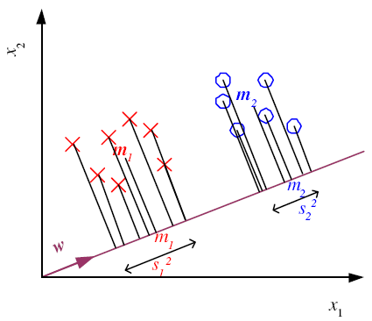
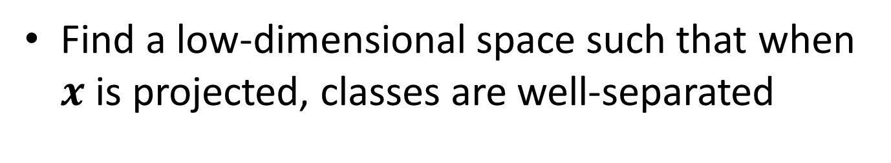
Linear Discriminant Analysis
Find a low-dimensional space such that when $x$ is projected, classes are well-separated

Slide 17
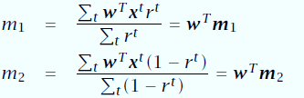
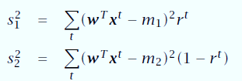
Means and Scatter after projection

Slide 18
Good Projection
Means are as far away as possible
Scatter is small as possible
Fisher Linear Discriminant

Slide 19
Thank You

